Slide 1
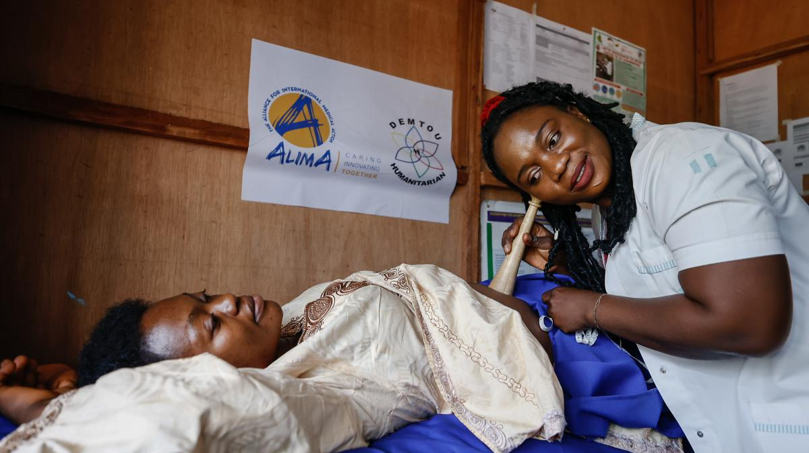
Research Presentation
Factors Associated with Women's Decisional Autonomy in Family Planning Among Women in Cameroon
A Multinomial Analysis of the 2018 Demographic and Health Survey

Slide 2
Presentation Overview
01
02
03
Background & Context
Maternal health crisis, Cameroon context, research gap
Methodology
Data source, sample, variables, regression & ML
Results
Descriptive statistics, distribution, regression
04
05
Machine Learning Analysis
Model comparison, SHAP analysis, live demo
Discussion & Conclusions
Key insights, policy recommendations, limitations

Slide 3
01 Background & Context
02 Methodology
03 Results
04 ML Analysis
05 Discussion
Background & Context
The Maternal Health Crisis in SSA
Research Gap
Sub-Saharan Africa accounts for 66% of global maternal deaths, with an estimated 546 maternal deaths per 100,000 live births. Unplanned pregnancies and short inter-pregnancy intervals remain leading contributors.
Most existing research examines binary outcomes — whether a woman has decision-making power or not. Fewer studies examine the full spectrum:
● Woman decides alone
● Husband/partner decides alone
● Joint decision-making
● Other decision-makers
The Cameroonian Context
53%
44%
of married women lack household decision-making autonomy
Sub-Saharan African average across 27 countries
This Study
Partner approval and intra-couple discussion are the two most significant factors associated with contraceptive use in Cameroon (Ajong et al., 2016; Edietah et al., 2018).
This study addresses this gap by examining the factors associated with each category of decisional autonomy using:
1. Multinomial logistic regression
2. Machine learning (7 algorithms)
3. SHAP feature interpretation
Data: 2018 Cameroon DHS-7 (N=1,533 married, non-pregnant contraceptive users)
Women with limited decision-making power are less likely to initiate or maintain contraceptive use, even when they desire to do so (Do & Kurimoto, 2012).
3 / 15

Slide 4
01 Background
02 Methodology
03 Results
04 ML Analysis
05 Discussion
Research Objectives & Data Source
SPECIFIC OBJECTIVES
1
Descriptive Analysis
Describe sociodemographic characteristics and distribution of FP decisional autonomy
2
Bivariate Associations
Examine associations between candidate variables and decisional autonomy
3
Multivariate + ML Analysis
Identify independent factors via multinomial regression and ML algorithms
DATA SOURCE & SAMPLE
Survey
2018 Cameroon Demographic and Health Survey (DHS-7)
Sampling Design
Stratified two-stage cluster sampling, nationally representative
Ethics
ICF IRB approved; DHS Program authorization obtained
Total DHS Sample
14,677 women aged 15–49
Analytical Sample
1,533
Married or cohabiting, non-pregnant women aged 15–49 who were current contraceptive users
Inclusion: V502=1 (married), V213=0 (not pregnant), V312≠0 (current user)
Pregnant women excluded because the decision-making context differs during pregnancy and to adhere to DHS-7 standards.
4 / 15

Slide 5
01 Background
02 Methodology
03 Results
04 ML Analysis
05 Discussion
Methodology & Outcome Variable
OUTCOME VARIABLE (V632)
STATISTICAL ANALYSIS
Code | Category | Role in Model
1 | Woman decides alone | Reference
2 | Husband/partner decides alone | Compared vs. ref.
3 | Joint decision | Compared vs. ref.
6 | Other (extended family) | Compared vs. ref.
1. Weighted descriptive statistics
2. Bivariate: Chi-square + Cramér's V (p<0.20 for model entry)
3. Multinomial logistic regression (RRR, 95% CI)
4. Model selection via AIC
5. Survey weights (v005) applied throughout
Software: Python 3.11 (statsmodels, scikit-learn)
UNFPA SDG 5.6.1 DETERMINANTS FRAMEWORK
Socio-demographic
Individual
MACHINE LEARNING PIPELINE
Age, residence, wealth, region, marital status, religion
Woman's education, employment, contraceptive method, fertility preference, parity
7 Algorithms: Random Forest, XGBoost, LightGBM, AdaBoost, Decision Tree, Logistic Regression, SVM
Preprocessing: 80/20 split, one-hot encoding, Z-score standardization
Tuning: 5-fold cross-validation, weighted F1 as primary metric
Interpretation: SHAP analysis for feature importance
Interpersonal
Institutional
Partner's education, desired children, occupation
ANC visits, FP counseling at facility, media exposure, fieldworker visits
5 / 15

Slide 6
01 Background
02 Methodology
03 Results
04 ML Analysis
05 Discussion
Distribution of Decisional Autonomy
Key Findings
57.3% Joint Decision
858 women — most common pattern, reflecting culturally negotiated contraceptive use where male involvement is normatively expected
26.0% Woman Alone
389 women — highest autonomy level, but only a quarter of the sample
16.6% Husband Alone
248 women — male-dominated decision-making with limited female agency
Insight: Over 73% of decisions involve husband input or control, highlighting the persistence of patriarchal household structures in Cameroon.
7 / 15

Slide 7
01 Background
02 Methodology
03 Results
04 ML Analysis
05 Discussion
Factors: Husband-Only vs Woman Alone
Multinomial logistic regression — Reference: Woman decides alone
PROTECTIVE FACTORS (RRR < 1)
Key Interpretations
Characteristic | RRR (95% CI) | Interpretation
Cohabiting (vs. Married) | 0.382 | 62% lower risk
Age 25–29 (vs. 15–19) | 0.357 | 64% lower risk
Age 35–39 (vs. 15–19) | 0.343 | 66% lower risk
Age 40–44 (vs. 15–19) | 0.321 | 68% lower risk
Working (vs. Not working) | 0.612 | 39% less likely
Marital Status
Cohabiting women have 62% lower relative risk of husband-only decisions (RRR=0.382, p<0.001). Formal marriage may reinforce traditional gender hierarchies.
Women's Age
Women aged 25–44 have 64–68% lower risk than adolescents, suggesting autonomy increases with age and life experience.
Employment
Working women are 39% less likely to experience husband-only decisions (RRR=0.612, p<0.05). Economic independence enhances reproductive agency.
Regional Effect
North (RRR=4.0) and North-West (RRR=5.4) show dramatically elevated risk, likely reflecting cultural norms and ethnic composition.
RISK FACTORS (RRR > 1)
Characteristic | RRR (95% CI) | Interpretation
No ANC visits | 3.216 | 3.2x higher risk
North region (vs. Adamawa) | 4.005 | 4x higher risk
North-West region (vs. Adamawa) | 5.430 | 5.4x higher risk
8 / 15

Slide 8
01 Background
02 Methodology
03 Results
04 ML Analysis
05 Discussion
Factors: Joint Decision vs Woman Alone
Multinomial logistic regression — Reference: Woman decides alone
FACTORS INCREASING JOINT DECISIONS
Key Interpretations
Characteristic | RRR (95% CI) | p-value
Husband: Primary (vs. None) | 2.758 | p<0.01
Husband: Secondary (vs. None) | 2.584 | p<0.05
Husband: Higher (vs. None) | 2.904 | p<0.05
Poorer wealth (vs. Poorest) | 1.262 | p<0.05
Centre region (vs. Adamawa) | 2.995 | p<0.05
North-West (vs. Adamawa) | 5.090 | p<0.01
Husband's Education
The strongest predictor — women with educated husbands are 2.6–2.9x more likely to report joint decisions. Notably, woman's own education showed no significant association.
Partner Pronatalism
When partners want more children, women are 67% less likely to be in joint decisions (RRR=0.333, p<0.001) — the strongest negative association.
Women's Employment
Working women are 36% less likely to be in joint decisions (RRR=0.638), suggesting economic independence enables independent rather than shared decision-making.
FACTORS DECREASING JOINT DECISIONS
Characteristic | RRR (95% CI) | p-value
Partner wants more children | 0.333 | p<0.001
Working (vs. Not working) | 0.638 | p<0.01
Partner "don't know" desires | 0.383 | p<0.001
9 / 15

Slide 9
01 Background
02 Methodology
03 Results
04 ML Analysis
05 Discussion
Regional Variations in Decisional Autonomy
Relative Risk Ratios (RRR) compared to Adamawa region (reference)
Region | Husband-Only RRR | p-value | Joint RRR | p-value
Adamawa (Ref) | 1.00 | — | 1.00 | —
Centre (without Yaounde) | 1.968 | ns | 2.995 | p<0.05
Douala | 2.899 | ns | 2.760 | p<0.05
North | 4.005 | p<0.05 | 2.091 | ns
North-West | 5.430 | p<0.05 | 5.090 | p<0.01
West | 1.525 | ns | 2.446 | p<0.05
South-West | 2.941 | ns | 3.699 | ns
East | 1.188 | ns | 0.646 | ns
Far-North | 0.429 | ns | 0.765 | ns
Key Takeaways
North-West shows the highest risk for both patterns (RRR=5.4 for husband-only, 5.1 for joint)
North is specific to husband-dominated decisions (RRR=4.0)
Centre, Douala, West show elevated joint decisions only
Regional targeting of interventions is essential different regions need different strategies
Note: ns = not significant. Only regions with significant associations are highlighted. Adamawa is the reference region.
10 / 15

Slide 10
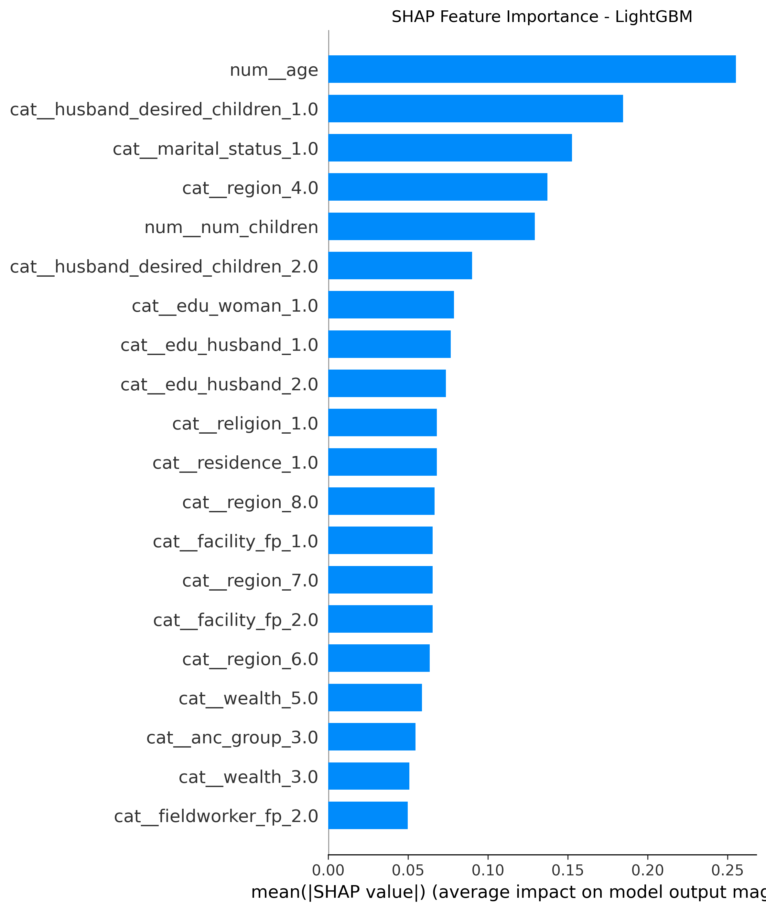
01 Background
02 Methodology
03 Results
04 ML Analysis
05 Discussion
Machine Learning Model Performance
MODEL COMPARISON (TEST SET)
SHAP ANALYSIS— LIGHTGBM
Model | Accuracy/ Weighted F1 | Std Deviation
LightGBM | 0.541 | ± 0.023
Random Forest | 0.531 | ± 0.016
XGBoost | 0.534 | ± 0.038
Logistic Regression | 0.488 | ± 0.014
AdaBoost | 0.516 | ± 0.040
SVM | 0.528 | ± 0.032
Decision Tree | 0.450 | ± 0.028
Key ML Findings
Best Model: LightGBM - 54.1% accuracy,
Classification Patterns: Joint decisions most accurately predicted (80.7% correct). Independent decisions frequently misclassified as joint, suggesting similar predictor profiles.
SHAP Corroboration: Top predictors (region, husband's education, partner fertility preferences, women's employment) align with regression findings.
Limitation: 43% prediction gap suggests unmeasured factors (psychological, relational, community-level) beyond DHS variables.
11 / 15

Slide 11
01 Background
02 Methodology
03 Results
04 ML Analysis
05 Discussion
Live ML Demo — Streamlit Application
An interactive web application for real-time prediction of women's family planning decisional autonomy in Cameroon.
Access the Application
macGPT Decisional Autonomy Predictor
LIVE STREAMLIT APP
macgpt-congenial-winner.streamlit.app
Input demographic and socioeconomic characteristics to receive a real-time prediction of the likely decision-making pattern for family planning in Cameroon.
SOURCE CODE
Key Features
github.com/Enow-brenda/congenial-winner
● Interactive prediction form with all DHS variables
● Real-time classification (Woman / Husband / Joint)
● SHAP force plot for explainable predictions
● Model performance comparison dashboard
● Built with Python, scikit-learn, and Streamlit
The application demonstrates the practical utility of the machine learning model by allowing users to explore how different demographic factors influence predicted decisional autonomy outcomes.
12 / 15

Slide 12
01 Background
02 Methodology
03 Results
04 ML Analysis
05 Discussion
Discussion: Key Insights
Husband's Education is the Critical Factor
Cohabiting Women Have More Autonomy
Women with educated husbands are 2.6–2.9x more likely to report joint decisions. Notably, woman's own education was not significant — highlighting that male educational attainment is the critical factor for couple communication about family planning.
Cohabiting women had 62% lower risk of husband-only decisions (RRR=0.382). Formal marriage may reinforce traditional gender hierarchies where husbands are positioned as primary decision-makers, while cohabiting unions offer more flexible dynamics.
Partner Pronatalism is a Major Barrier
Women's Employment Enables Independence
When partners want more children, women are 67% less likely to be in joint decisions (RRR=0.333) and more likely to experience husband-only decisions. Fertility preference discordance within couples substantially constrains women's reproductive agency.
Working women were protected against both husband-only (RRR=0.612) and joint (RRR=0.638) decision-making, suggesting economic independence enables women to make decisions independently rather than sharing or ceding control.
Regression + ML Convergence
Both analytical approaches converged on region, husband's education, partner's fertility preferences, and women's employment as the most robust predictors. The modest ML predictive performance (54% accuracy) suggests that decisional autonomy is inherently complex and influenced by unmeasured psychological, relational, and community-level factors beyond DHS variables.
13 / 15

Slide 13
01 Background
02 Methodology
03 Results
04 ML Analysis
05 Discussion
Conclusions & Recommendations
POLICY RECOMMENDATIONS
1
Target Male Partner Education
2
Couple-Based Fertility Counseling
3
Economic Empowerment Programs
FP programs should include male educational components and target couples rather than women alone
Address fertility preference discordance through couple-based counseling on family size preferences
Invest in women's economic opportunities to enhance household negotiating power and reproductive agency
4
ANC-Based Family Planning Counseling
5
Regional Targeting of Interventions
Health facilities should systematically provide FP counseling to all women attending ANC services. No ANC was associated with 3.2x higher risk of husband-only decisions.
Focus on North and North-West for husband-dominated decisions; Centre, Douala, and West for promoting joint decision-making.
LIMITATIONS
1. Cross-sectional design precludes causal inference associations reflect correlations to be interpreted cautiously
2. Domestic violence module could not be included due to high missingness, potentially omitting an important determinant of reproductive coercion
3. Household decision-making variables (v743a-f) were excluded given conceptual proximity to the outcome variable
4. Cluster-level variables that might justify multilevel modelling were not explored in this analysis
14 / 15

Slide 14

Thank You
This study contributes to the growing evidence base on women's reproductive autonomy in Central Africa, providing actionable insights for policy and programme design.
RESOURCES
● GitHub Repository
● Streamlit Predictor App
Cameroon DHS 2018 | N = 1,533

